Slide 1

Data Science For Business
January 2025
Module 2 – Supervised Segmentation

Slide 2
EV[Decision] >= EV[Not Decision]

Slide 3
Quiz time!

Slide 4
Quiz discussion!

Slide 5
Q1
What is the primary difference between L1 and L2 regularization?
 | L1 regularization penalizes the sum of weights, L2 penalizes the sum of squared weights.
 | L2 regularization penalizes the sum of weights, L1 penalizes the sum of squared weights.
 | L1 regularization penalizes the sum of absolute value of the weights, L2 penalizes the sum of squared weights.
 | L2 regularization penalizes the sum of absolute value of the weights, L1 penalizes the sum of squared weights.

Slide 6
Q1
What is the primary difference between L1 and L2 regularization?
 | L1 regularization penalizes the sum of weights, L2 penalizes the sum of squared weights.
 | L2 regularization penalizes the sum of weights, L1 penalizes the sum of squared weights.
 | L1 regularization penalizes the sum of absolute value of the weights, L2 penalizes the sum of squared weights.
 | L2 regularization penalizes the sum of absolute value of the weights, L1 penalizes the sum of squared weights.

Slide 7
Q2
What is the purpose of regularization in logistic regression?
 | To increase the complexity of the model.
 | To ensure the model fits the training data perfectly.
 | To penalize complex models and reduce overfitting.
 | To avoid using nonlinear features.

Slide 8
Q2
What is the purpose of regularization in logistic regression?
 | To increase the complexity of the model.
 | To ensure the model fits the training data perfectly.
 | To penalize complex models and reduce overfitting.
 | To avoid using nonlinear features.

Slide 9
Q3
In linear/polynomial regression, we can increase the degree of the model to increase the complexity. We can also increase complexity by
 | increasing regularization on the model in the training process
 | decreasing regularization on the model in the training process

Slide 10
Q3
In linear/polynomial regression, we can increase the degree of the model to increase the complexity. We can also increase complexity by
 | increasing regularization on the model in the training process
 | decreasing regularization on the model in the training process

Slide 11
Q4
Describe the difference between a fitting curve and a learning curve. What is on the x and y axis for each? You can write this in bullet point format.

Slide 12
Q4
Describe the difference between a fitting curve and a learning curve. What is on the x and y axis for each? You can write this in bullet point format.

Slide 13
Q5
You are tasked with building a model to predict whether a new type of concrete mixture will achieve a compressive strength of 35 MPa or more. Your dataset contains multiple features, such as the quantities of cement, water, and aggregate, and you observe that some features have values ranging from 0 to 1, while others range from 0 to 1000. You have information on the target variable. Your boss wants you to create a decision tree to model this process. Unfortunately, the standard regularization approach of penalizing weights cannot be applied to decision tress because they are not directly minimizing a loss function/maximizing an objective function. How might you ensure that this decision tree does not overfit the training data?

Slide 14
Agenda
Week 1
Module 1 (Thursday): Intro to data science + Python for DS
Module 2 (Friday): Intro to supervised learning
Week 2
Module 3 (Monday): Fitting models, generalization
Module 4 (Tuesday): Regularization
Module 5 (Wednesday): Evaluation (ROC, cost visualization)
Module 6 (Thursday): Modeling text data
Week 3
Module 7 (Monday): Neural networks, GenAI
Module 8 (Tuesday): Guest lecture(s)
Module 9 (Wednesday): Causal inference, AB testing, wrap up
Final Exam (Thursday)

Slide 15
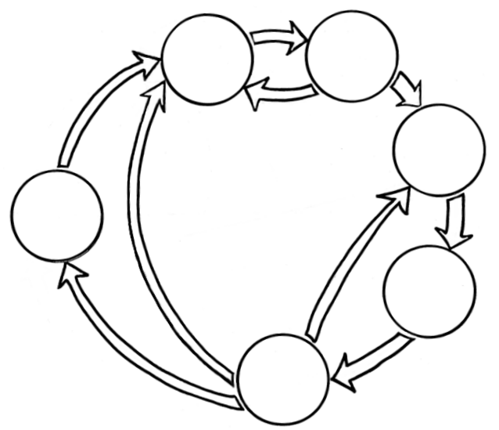
Where we are
Business Understanding
Data Understanding
So far
Data Preparation
Data Science
Process
Deployment
Modeling
Evaluation

Slide 16

Where we are
Business Understanding
Data Understanding
So far
Data Preparation
Data Science
Process
Deployment
Modeling
Evaluation

Slide 17
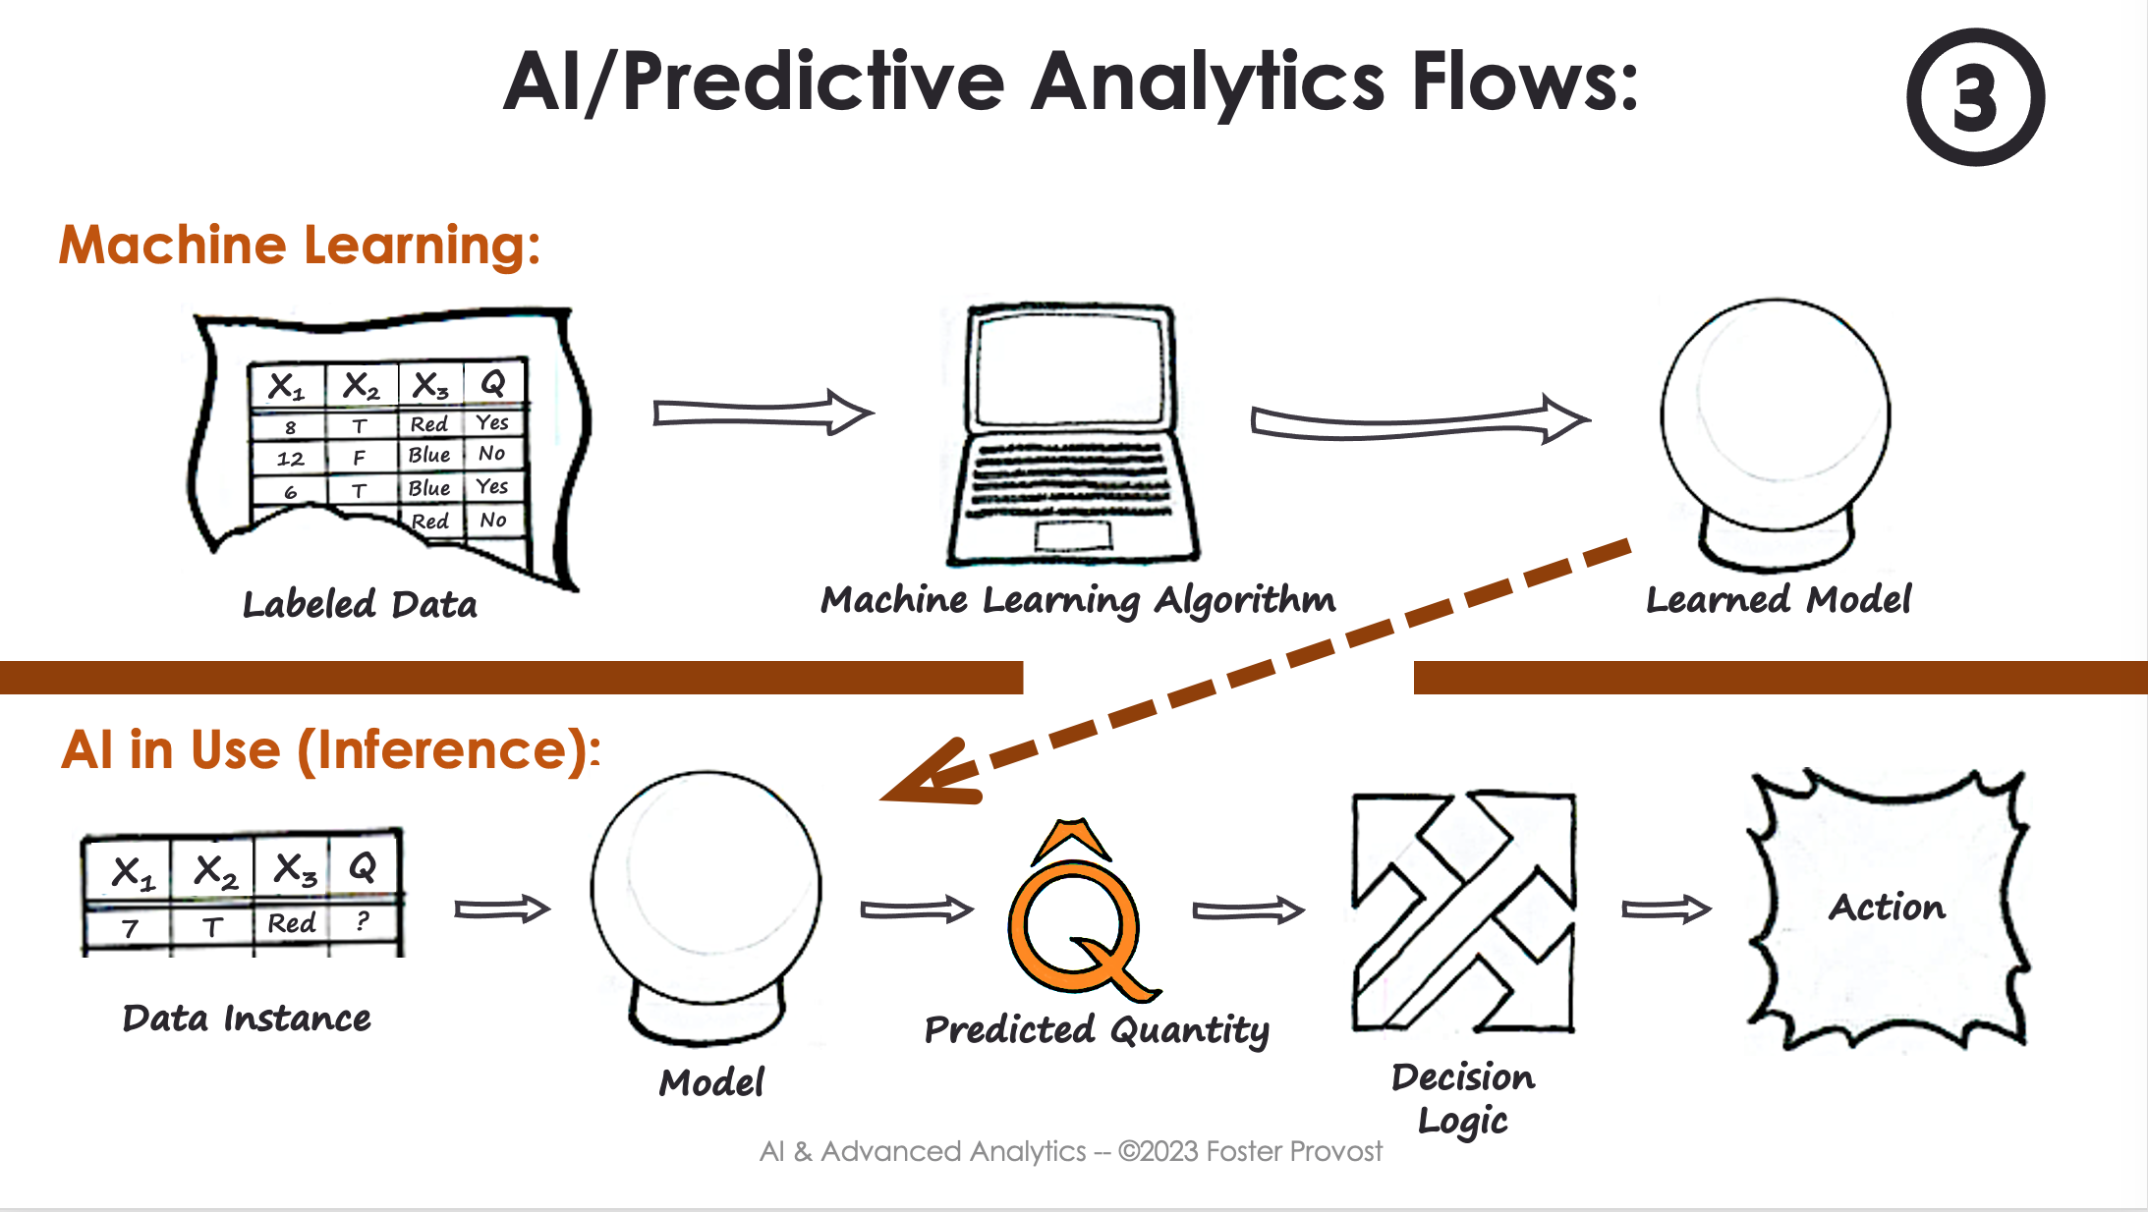
Where we are
So far

Slide 18

Where we are
So far

Slide 19
Where we are
Business Understanding
Data Understanding
Today
Data Preparation
Data Science
Process
Deployment
Modeling
Evaluation

Slide 20
Where we are
Today

